Slide 1
Regular Expressions
BC-COMS2710 Computational Text Analysis
Summer A

Slide 2
Motivation
Searching for text strings is clearly a vital task in text analysis
What if we want to search for a pattern or variations of a string, rather than a single specific string?
misspelled words, plural/singular words, capitalized/uncapitalized, British/American spellings etc.
Ex: variations on “hello”: “Hello”, “hellooo”, “hellooooooo”
Regular Expressions, or RegEx are flexible patterns which allow us to specify all desired variations of a string in a single line

Slide 3
Without Regex
To find all matches of “hello” with possible additional “o”’s in a string, need a for loop, multiple conditional statements
for i in range(len(string)):
If ….
Lot of work for a relatively simple, frequently used task

Slide 4
With Regex (in Python)
import re
txt = "hello hellloooo hellooooo helloo"
x = re.findall(r"hello+", txt)
#x will be a list of strings containing matches of the pattern in the text

Slide 5
RegEx Examples (Quantifiers)
hello+
Matches “hello”, “helloo”, “hellooo” etc.
cooo*l
Matches “cool”, “coool”, “cooool”, etc.

Slide 6
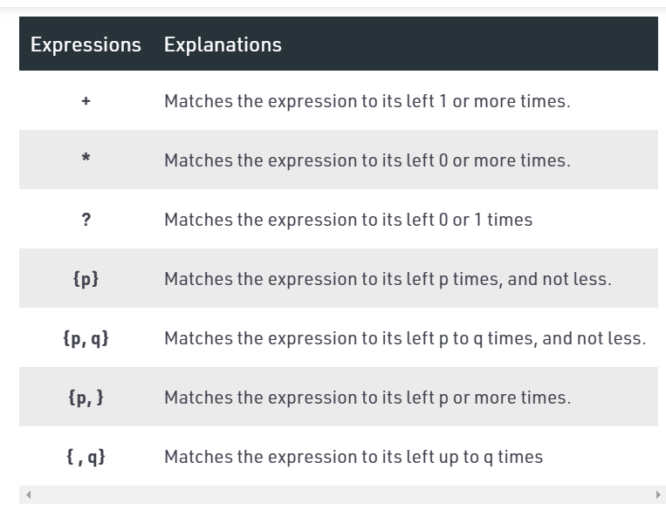
Quantifiers

Slide 7
Exercises + Cheatsheet
Cheatsheet: https://www.debuggex.com/cheatsheet/regex/python
Kahoot: www.kahoot.it

Slide 8
Quantifiers Exercise
Which regex would NOT match all words beginning with ‘a’ and are followed by at least one ‘n’ ? (Ex. “annual”, “antique”)
an+
an*
an{1,}

Slide 9
Quantifiers Exercise Solution
Which regex would NOT match all words beginning with ‘a’ and are followed by at least one ‘n’ ? (Ex. “annual”, “antique”)
an+
an*
an{1,}
Explanation: The answer is B since the regex an* would also match words beginning with ‘a’ but having 0 ‘n’s following it. Answer C is equivalent to answer A.

Slide 10
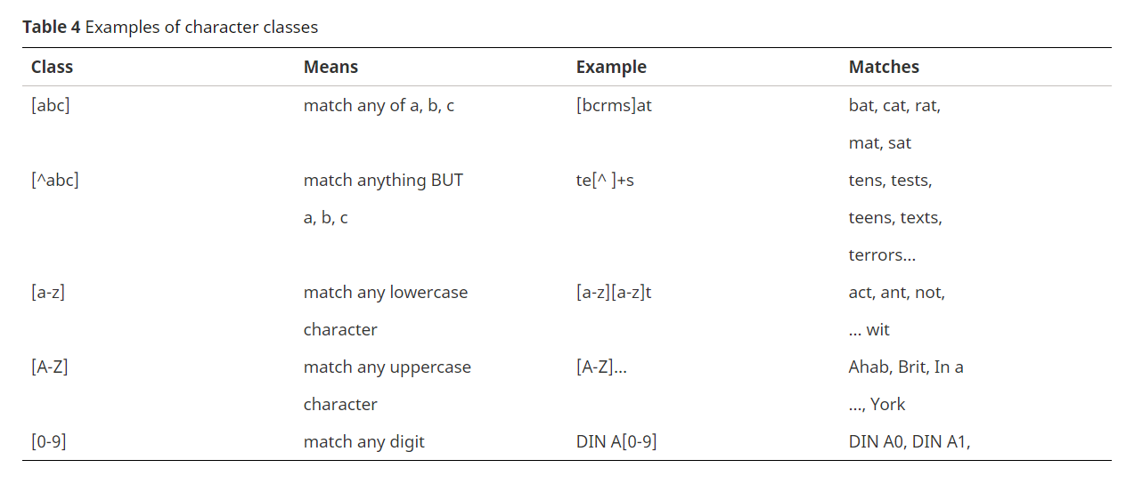
Character Classes (Sets)

Slide 11
Character Classes-
Can make custom ranges using subsets of alphanumeric characters
Ex. [a-m], [0-5]
Ex. [ab-e] == [abcde]

Slide 12
2. Characters Exercise
Which regex would match all words that rhyme with “mouse”?
[a-z]ouse
[^m]ouse
[a-z]+ouse

Slide 13
2. Characters Exercise Solution
Which regex would match all words that rhyme with “mouse”?
[a-z]ouse
[^m]ouse
[a-z]+ouse
Explanation: The answer is C since there may be more than one preceding character to “ouse”, which the ‘+’ accounts for. B is incorrect because there are non alphabetical characters which it would match.

Slide 14
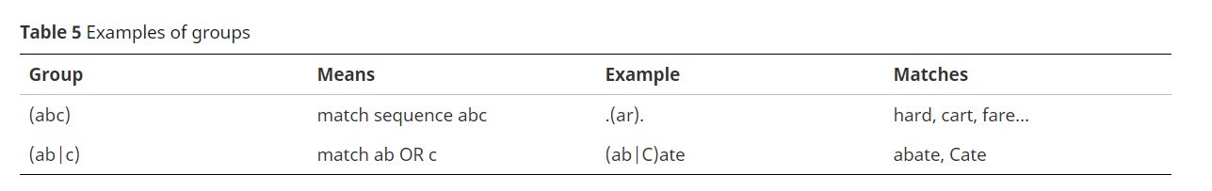
Groups

Slide 15
3. Groups Exercise
Which regex would match with all words rhyming with mouse, but not including mouse?
[a-l | n-p]+ouse
[^m]ouse
[^m](ouse)

Slide 16
3. Groups Exercise Solution
Which regex would match all words rhyming with mouse, but not including mouse?
[a-l | n-p]+ouse
[^m]ouse
[^m](ouse)
Explanation: The answer is technically A, since B and C could match non alphabetic first characters. B and C are equivalent.

Slide 17

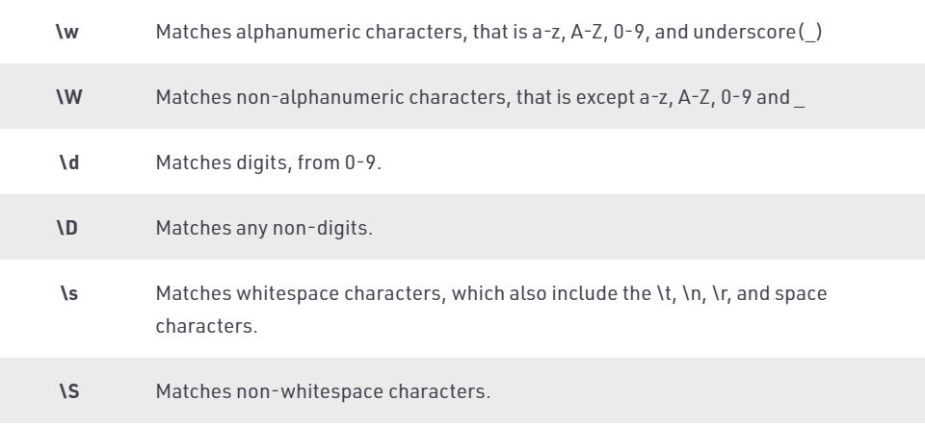
Special Characters: Shorthand Character Classes

Slide 18

Special Characters: Whitespace

Slide 19
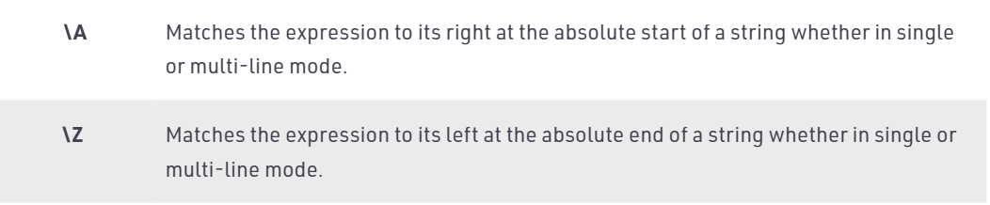
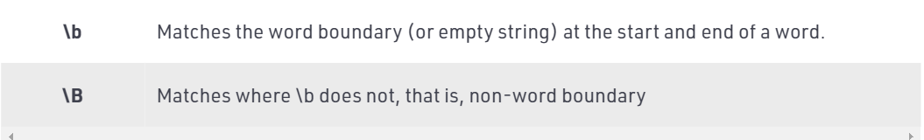
Special Characters: “Empty” Strings

Slide 20
4. Special Characters Exercise
Which regex would match only distinct words rhyming with mouse (including mouse)?
[a-z]+ouse
[a-z]+ouse\b
[.]+ouse\b

Slide 21
4. Special Characters Exercise Solution
(Same question as before)
Which regex would match only distinct words rhyming with mouse, (including mouse)?
[a-z]+ouse
[a-z]+ouse\b
[.]+ouse\b
Explanation: B is correct because the word boundary ‘\b’ ensures that the word ends in “ouse” and [a-z] ensures that the preceding characters are alphabetical.

Slide 22
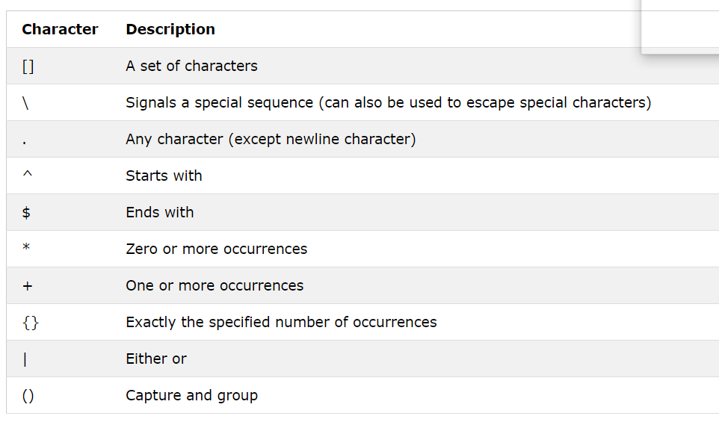
Metacharacters

Slide 23
Escape Character
The escape character is “\“
Must be used for specifying metacharacters
Example:
to match “^”, regex is “\^”
To match “\t” (but not tab character), regex is “\\t”
And to match “ (quotation mark), regex is “\””
Exception: inside a set [] or a group (), metacharacters are literals
In regex “(+*?)”, no need for escape characters to specify + * ?

Slide 24
5. Metacharacters Exercise
Which regex would match all sentences ending with the word ‘farewell’ (assuming all sentences end in a period) ?
farewell.
\sfarewell.
\bfarewell\.

Slide 25
5. Metacharacters Exercise Solution
Which regex would match all sentences ending with the word “farewell” (assuming all sentences end in a period) ?
farewell.
\sfarewell.
\bfarewell\.
Explanation: C is correct because the empty space ‘\s’ ensures that it is in fact the last word, and the escape character before the period ensures that it is read as a period in the regex.

Slide 26
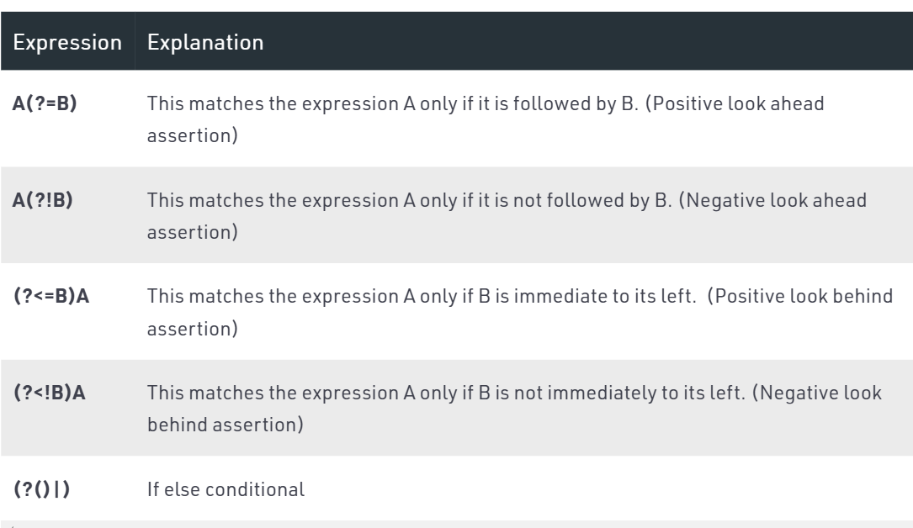
Lookarounds (Assertions)

Slide 27
6. Lookarounds Exercise
Which regex would match all names with the title “Dr. ” ? e.g. “Dr. Livingston”
(?=Dr. ).+\b\s
(?<=Dr\. ).+\b\s
(?=Dr\. ).+\b\s

Slide 28
6. Lookarounds Exercise Solution
Which regex would match all names (with titles) where the title is “Dr. ” ? e.g. “Dr. Livingstone”
(?=Dr. ).+\b\s
(?<=Dr\. ).+\b\s
(?=Dr\. ).+\b\s
Explanation: The (?<=) expression will return matches only for where the immediately preceding characters are “Dr\. “
B is therefore incorrect because it will only get the name, not the title.
A is incorrect because it does not include the escape character for the period.

Slide 29
More Cheatsheets/References
https://learnbyexample.github.io/python-regex-cheatsheet/
https://pythex.org/ --Regex checker
https://www.geeksforgeeks.org/python-regex-cheat-sheet/

Slide 30
Limitations of Regex in Application
You have to already know what you’re looking for
be familiar with the text prior to using regex
Easy to get false positives or false negatives of desired result
Can get complicated and lose readability
Can get computationally expensive
Every language/library is different in terms of optimization
Best practice:
use for simple patterns (more than just a substring)
test expected results, desired positives and negatives before hand
Thoroughly validate results

Slide 31
Sources
Computational Text Analysis in Python Ch. 3
Jurafsky slides
https://www.geeksforgeeks.org/python-regex-cheat-sheet/
https://learnbyexample.github.io/python-regex-cheatsheet/

